Slide 1



11 Nov 2023
Linear regression, PCA... and some RNA-seq
NEUROSYSM930
Gonzalo Nido
gonzalo.nido@uib.no

Slide 2
Outline Day 3
Introduction to Day 3
Linear regression
PCA
RNA-seq (again)
Hands-on for Day 3

Slide 3
Introduction to Day 3
Structure of biological information

Slide 4
Molecular biology dogma
regulation
DNA
RNA
protein
information
messenger
function

Slide 5
Biological organization
layers of biological organization
Hierarchical organization
Also in different time/space scales!
Layer boundaries not always well defined
Regulation within- and between layers
“Dynamic” stability → homeostasis
Changes in one or more elements disrupting homeostasis → Disease
Spot the significant* difference
organism
tissue
cell
biomolecular complex
molecule

Slide 6


Clinical research
A needle in the haystack
Models (in vitro, in vivo animal models)
Disruption/perturbation isolated from other variables
Translation to human disease often challenging
Human samples
Single cell vs tissue
Fresh tissue vs post-mortem tissue
Molecular readouts: samples as snapshots
Uni-dimensional / multi-dimensional observations
Post-translational modifications
Transcript levels
DNA
RNA
protein
Histone modifications
Genetic variation
Epigenetic variation
Protein levels
Post-transcriptional modifications
metabolites
Notes:
a

Slide 7

High-dimensional biology
Omics research, big-data, high-throughput
Complex systems can be better understood if considered as a whole
Hypothesis-driven vs hypothesis-generating
genomics
epigenomics
transcriptomics
proteomics
metabolomics
NGS-based
Notes:
a
data matrices

Slide 8

Typical data structures in bioinformatics
Metadata
"Description" of the samples
Samples (observations) in rows / Variables in columns
A sample doesn't have to be an individual!
Types of variables
Quantitative
Integer (e.g., 1, 2, 545, 100014)
Float ("numeric" in R): (e.g., 12.3, 1.23, 1.0)
Categorical ("factors" in R)
Ordinal (e.g., small, medium, large)
Nominal (e.g., red, blue, green)
Boolean (0, 1)
Typically, manageable matrix sizes
sample_id | individual | sex | RIN | age | tissue | condition
pfctx001 | KBR | M | 8.2 | 38 | muscle | control
pfctx002 | FDI | F | 7.7 | 34 | muscle | control
pfctx003 | GNI | M | 4.2 | NA | muscle | control
pfctx004 | CTZ | M | 8.1 | 42 | muscle | case
pfctx005 | CTZ | M | 9.0 | 42 | PFC | case
... | ... | ... | ... | ... | ... | ...
pfctx059 | JLO | F | 2.3 | 51 | muscle | case
Most often, we care about one of these columns
Which doesn't mean that the other columns can be discarded!

Slide 9
Typical data structures in bioinformatics
Data
Experimental measurements
Variables (e.g., genes) in rows / Samples in columns
In omics data, typically high collinearity between variables
Typical variable types in omics
Integer (e.g., RNA-seq)
Float: (e.g., methylation data)
Very often non-normally distributed! (intensities, expression levels...)
Large or VERY LARGE matrices, up to several million rows
gene_id | pfctx001 | pfctx002 | ... | pfctx059
A1BG | 1024 | 873 | ... | 12
A1CF | 12 | 23 | ... | 11
A2M | 4888 | 9383 | ... | 3334
A2ML1 | 498 | 477 | ... | 501
A3GALT2 | 10323 | 9123 | ... | 8767
... | ... | ... | ... | ...
ZZZ3 | 34 | 52 | ... | 101
Usually, the challenge is to select which variables are interesting

Slide 10
How do we assess association between variables?
Is condition associated with age?
is the average age different in cases and controls?
t-test (case/control), ANOVA (PD/AD/control)
Wilcoxon (case/control), Kruskal-Wallis (PD/AD/control)
Do we have an overrepresentation of muscle tissue for either cases or controls?
Contingency table
Chi-square / Fisher's test
Is RIN associated with age?
Pearson correlation
Spearman correlation
sample_id | individual | sex | RIN | age | tissue | condition
pfctx001 | KBR | M | 8.2 | 38 | muscle | control
pfctx002 | FDI | F | 7.7 | 34 | muscle | control
pfctx003 | GNI | M | 4.2 | NA | muscle | control
pfctx004 | CTZ | M | 8.1 | 42 | muscle | case
pfctx005 | CTZ | M | 9.0 | 42 | PFC | case
... | ... | ... | ... | ... | ... | ...
pfctx059 | JLO | F | 2.3 | 51 | muscle | case

Slide 11
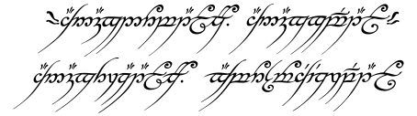
Linear regression
One Method to rule them all, One Method to find them, One Method to bring them all, and in the darkness bind them

Slide 12
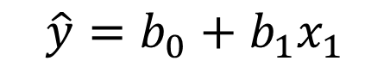
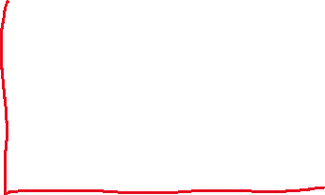

Linear regression
* One Method to rule them all, One Method to find them, One Method to bring them all, and in the darkness bind them
"Summarize and study relationships between two continuous (quantitative) variables"
Correlation only indicates direction and strength of association...
For every 10 years we age, how methylated is our genome?
What should be the methylation for a given age?
Correlation doesn't change when changing scales
A regression models y as a linear function of x:
methylation
$$\hat{y}=b_{0}+b_{1}x_{1}$$
age
Notes:
Predict vs infer!

Slide 13

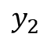

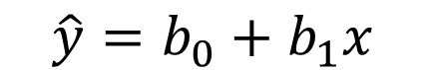
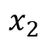
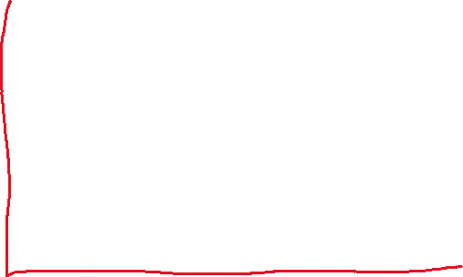
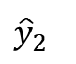
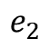
Linear regression
$$\hat{y}=b_{0}+b_{1}x$$
The residuals (e_{i}) are the errors between the observed y_{i} and the theoretical ŷ_{i}
ŷ can also be seen as the predicted mean of a population with a given x
b₁ is the slope (the rate of change of y per unit of x, the "effect size")
b₀ is the y-intercept and often does not make sense
Actually, x can be a categorical variable, enconded as 0 and 1
methylation
$$y_{2}$$
$$e_{2}$$
$${\hat{y}}_{2}$$
$$x_{2}$$
age

Slide 14



Categorical variables as independent variable
met | cohort
-0.12 | NB
0.45 | PW
0.75 | PW
-0.42 | NB
0.88 | KL
0.13 | PW
-0.22 | NB
...
0.54 | KL
NB | PW
1 | 0
0 | 1
0 | 1
1 | 0
0 | 0
0 | 1
1 | 0
... | ...
0 | 0
methylation
cohort_NB
methylation
sex
methylation
cohort_PW

Slide 15
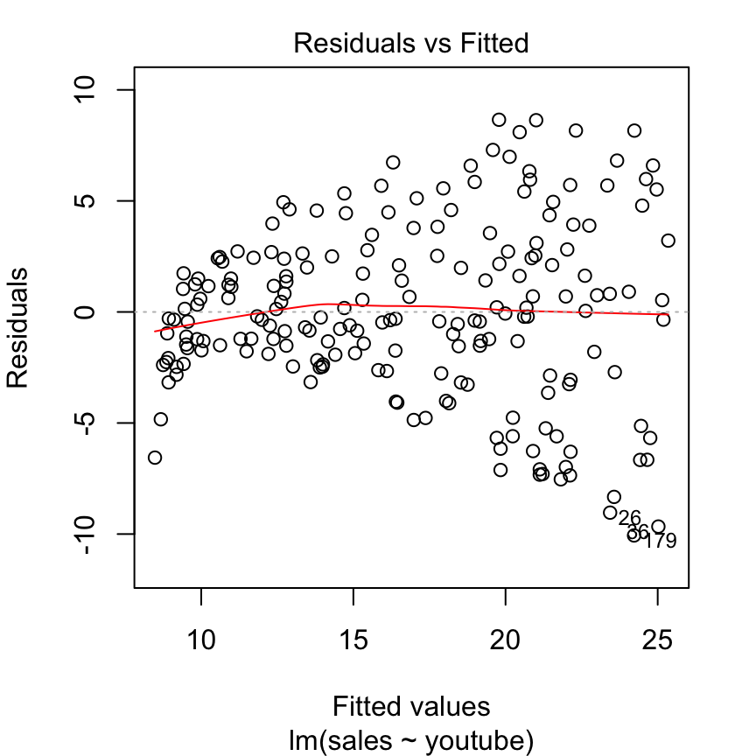
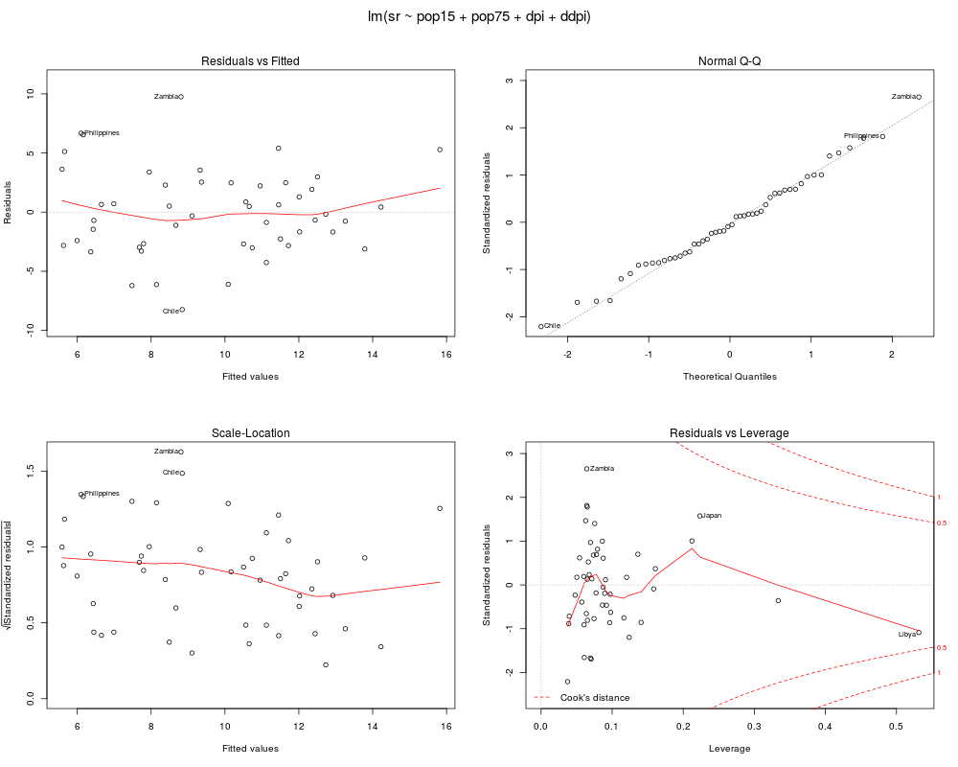
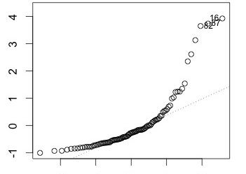
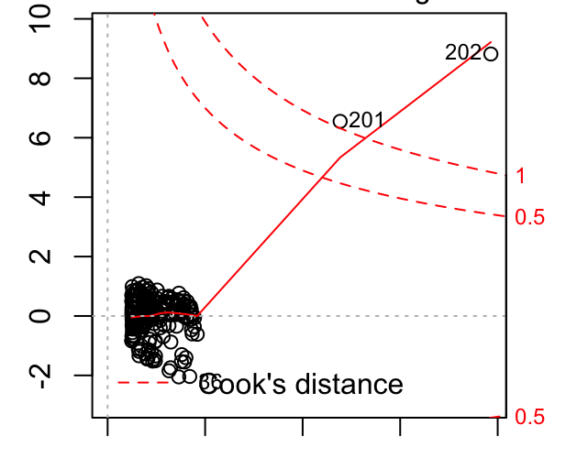
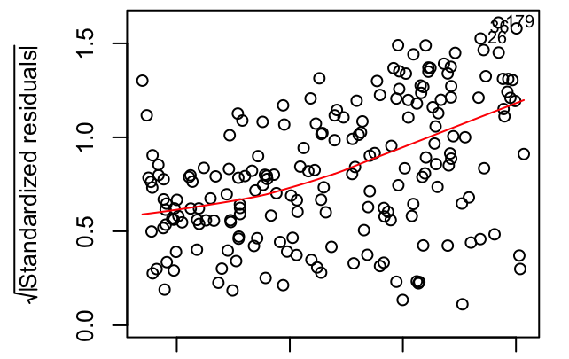
Linear regression assumptions
The assumptions of a linear model are never perfectly met, but we need to check if they are reasonable
What we mostly care about is the errors (residuals)
Independence: Observations are independent of each other
Before analyzing the data!
Linearity: The relationship between X and Y is linear
Residuals should look flat when plotted against Y
Homoscedasticity: The variance of residuals is the same for any value of Y
Variance of residuals should look flat when plotted against Y
Normality: For any fixed value of X, Y is normally distributed
Residuals are normally distributed
Notes:
p1: linearity (red line) but also cloud (homoscedasticity)
p2: normal distribution of residuals
p3: same as p1 but residuals have no sign
p4: influential cases (outliers?)
a -> bad examples

Slide 16
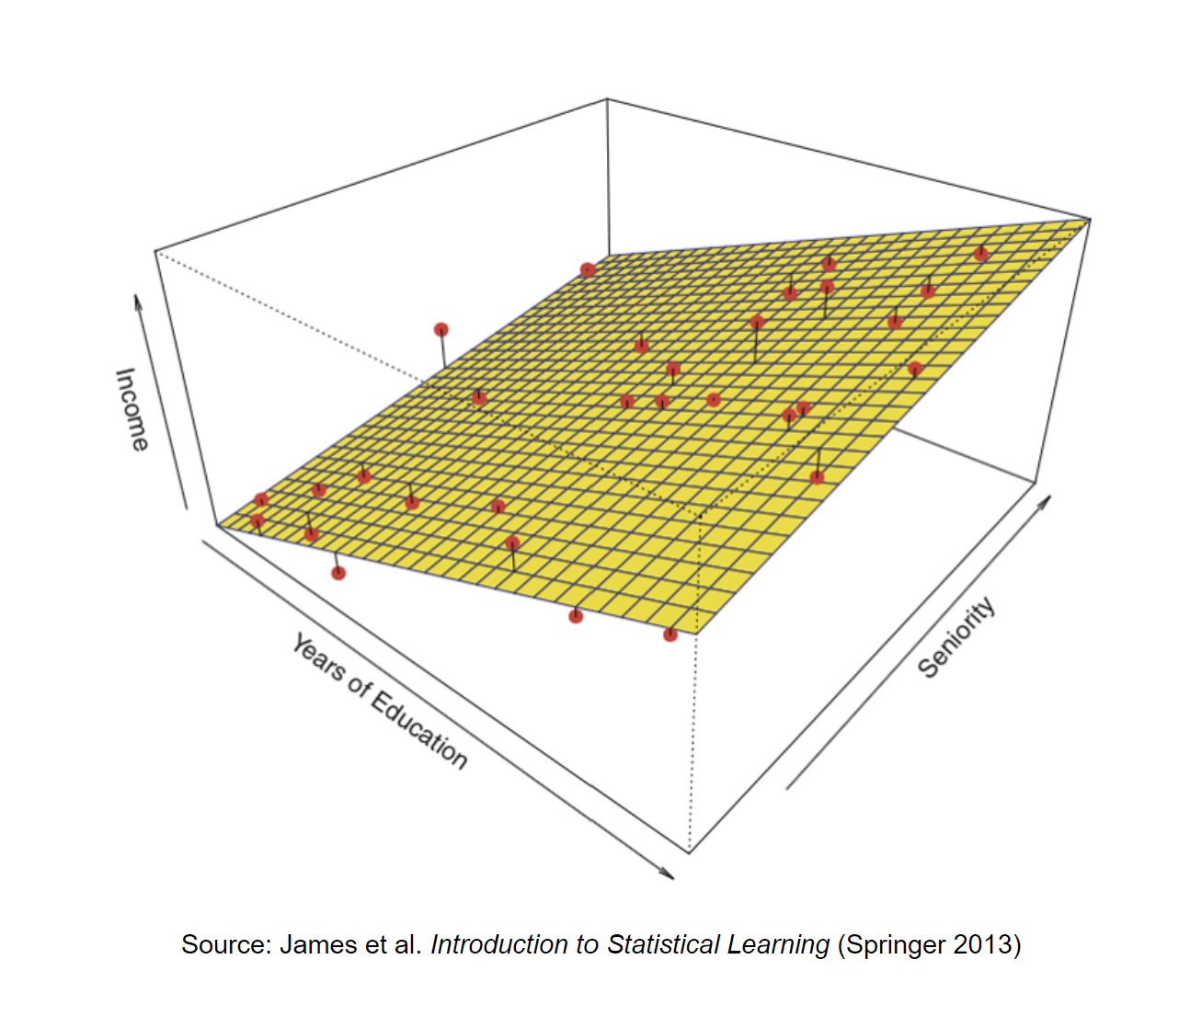
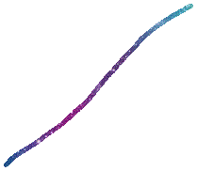

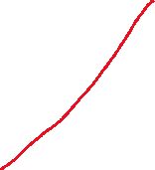
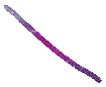
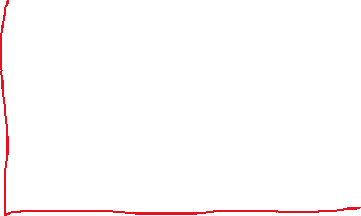


Multiple linear regression
$$\hat{y}=b_{0}+b_{1}x_{1}+x_{2}b_{2}+…$$
The regression is now a linear combination of multiple variables (x₁, x₂, ...)
Residuals are still only one per observation (ŷ_{i} – y_{i}) (diagnostic plots are very, very useful!)
Collinearity between covariates does not bias results but it produces large standard errors in the related independent variables: increase of type II error
methylation
age
sex
Notes:
a -> better plot
n -> categorical vars

Slide 17

Categorical variables
met | age | cohort
-0.12 | 76 | NB
0.45 | 55 | PW
0.75 | 95 | PW
-0.42 | 36 | NB
0.88 | 38 | KL
0.13 | 52 | PW
-0.22 | 73 | NB
...
0.54 | 77 | KL
NB | PW
1 | 0
0 | 1
0 | 1
1 | 0
0 | 0
0 | 1
1 | 0
... | ...
0 | 0
$$\hat{M}=b_{0}+b_{1}\text{age}$$
$$\hat{M}=b_{0}+b_{1}\text{age}+b_{2}\text{NB}+b_{3}\text{PW}$$
Notes:
a -> conversion to dummy

Slide 18

Generalized linear regression
$$\hat{y}=b_{0}+b_{1}x$$
When the relationship between y and x is not linear, other types of regressions are possible
"transforming" your y to make it linear
What type of variable is your y?
Logistic regression: 0 < y < 1
Used when y is a probability
Used when y is categorical binary variable (e.g., case/control)
Poisson / Negative binomial
Count data (e.g., RNA-seq)
sex
$$x_{2}$$
height
NB: Your estimates (coefficients) will mean something different!
Notes:
a -> curve

Slide 19
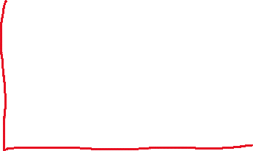


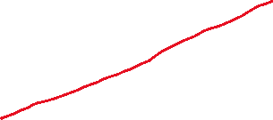
A simple example
$$methylation=b_{0}+b_{1}age$$
$$methylation=b_{0}+b_{1}age+b_{2}sex$$
methylation
The rate of methylation increase with age is the same for both groups, but they have different "start points"
age
Notes:
a -> lots

Slide 20
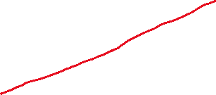

A not-so-simple example: interaction terms
$$m=b_{0}+b_{1}age+b_{2}sex$$
$$m=b_{0}+b_{1}age+b_{2}sex+ b_{3}age∗sex$$
methylation
The rate of methylation increase with age is different for these groups!
(assuming sex==red as 0) b3 will be negative (around -1)
age
Notes:
a -> lots

Slide 21
What are we not covering
Random effects
Observations are not independent,
e.g., several tissues from an individual, different researchers sampling, several timepoints for the same individual, intra-sample control...

Slide 22
Principal component analysis
The most useful dimensionality reduction tool in the known Universe

Slide 23
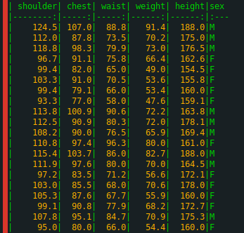
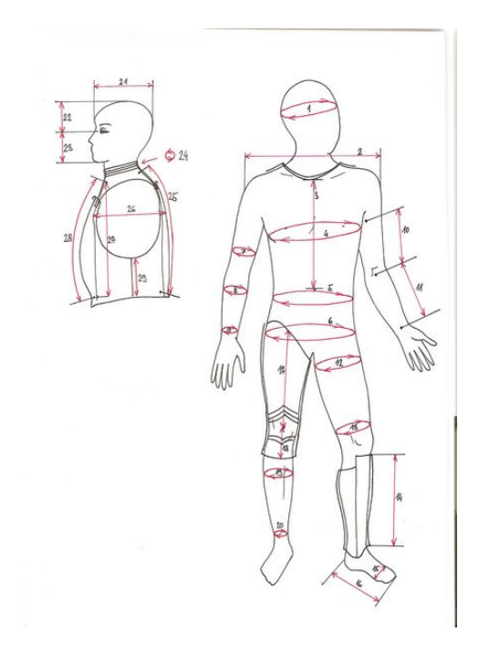
Body data set
20 individuals
5 variables:
Shoulder girth
Chest girth
Waist girth
Weight
Height

Slide 24
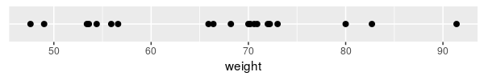

1D plot

Slide 25
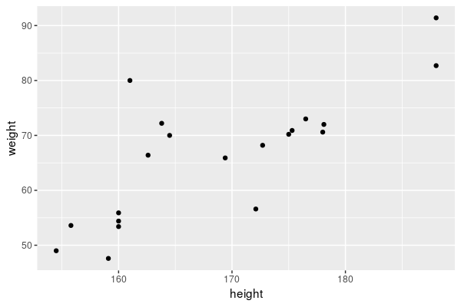
2D plot
Weight
Height

Slide 26
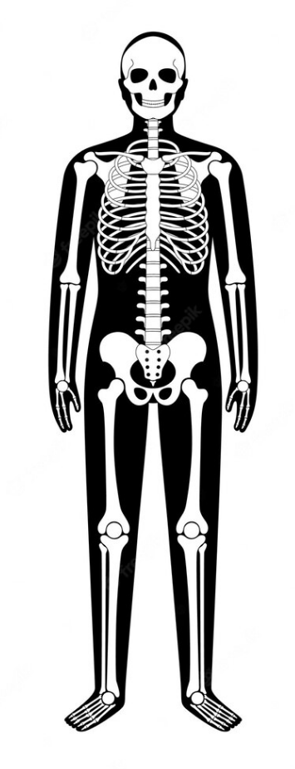
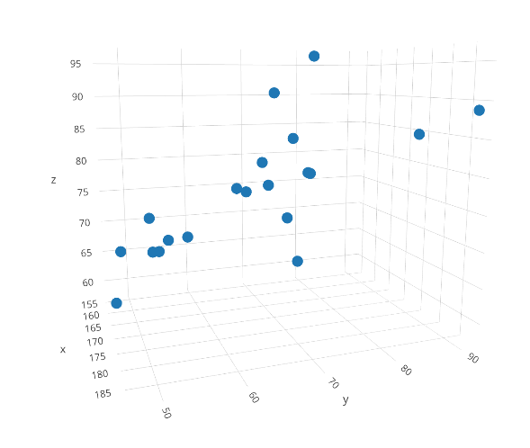
3D plot
Weight
Height
Waist

Slide 27

4D plot

Slide 28
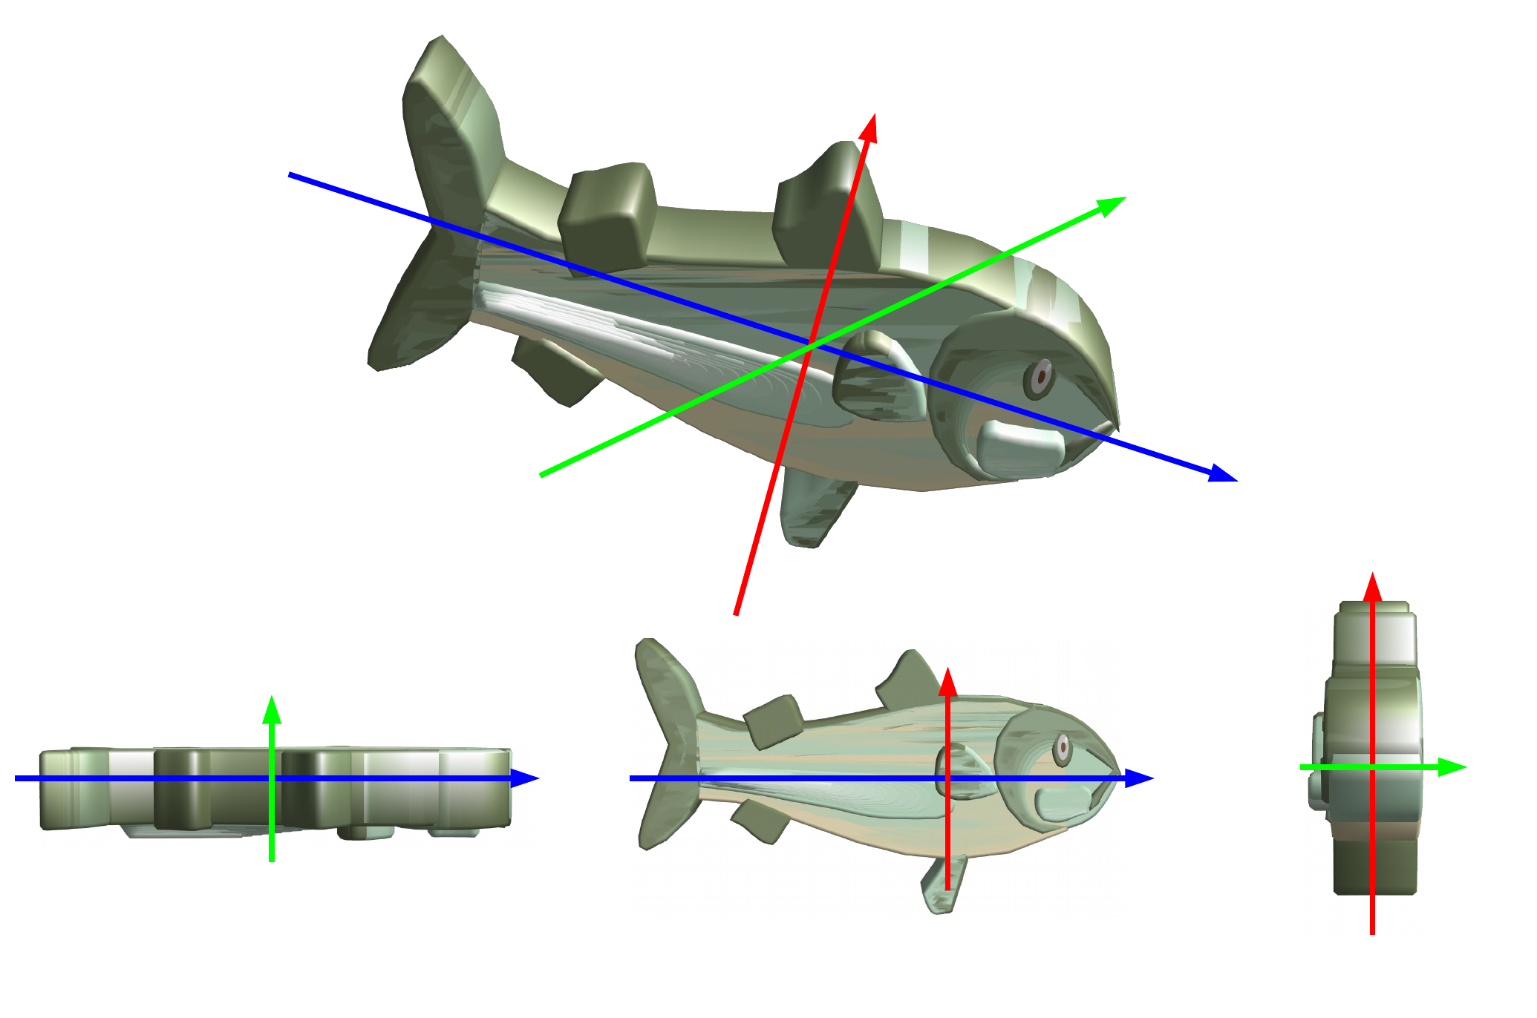
What do you see?
Not all projections allow the same information to be extracted
The projection was made on the plane formed with the 2 directions in which the object spreads out the most
3d dimension doesn't add much, its loss is not a problem to recognize the object

Slide 29
Back to the body data set
3d_plot.html

Slide 30
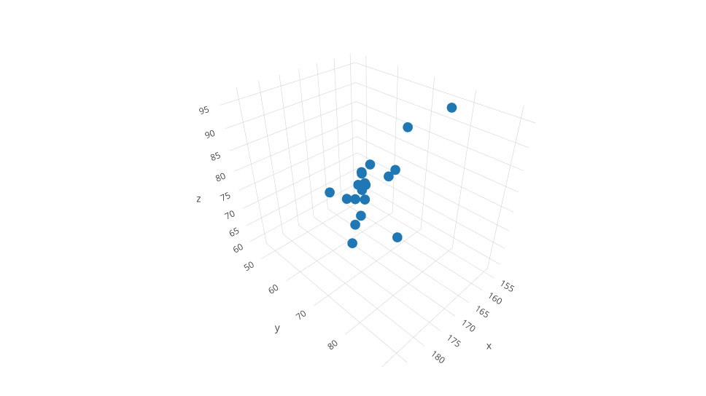
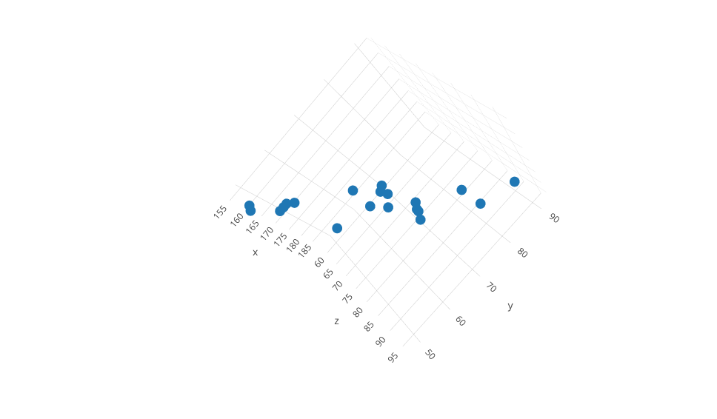
Looking at the world from a different angle...
beefiness

Slide 31
PCA in a nutshell
PCA allows to determine the subspaces of lower dimension that the original space on which the projection is the least modified, i.e., that keep the greatest part of variability
The first PC is the linear combination of the original variables that maximizes the variance
The more correlated your original variables are, the more percent of variance you will be able to explain in the first PC
Take whatever variance is left, and do the same again to find the second PC (and so on...)
Each sample is assigned a score on each new PC dimension
Preserves the global structure of the data
It is deterministic

Slide 32
Practical aspects
Should I scale my data before PCA?
Without scaling: one variable with high variance will dominate nearly alone the first PC
With scaling: one noisy variable with low variability will be given the same variance as other more "meaningful" variables
Can I perform PCA with missing values?
You can impute the missing values or,
Use methuds such NIPALS to impute them as you calculate the PCA
The best thing to do about missing data is not to have any

Slide 33
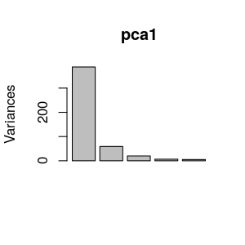
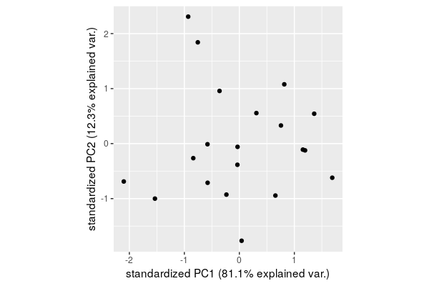
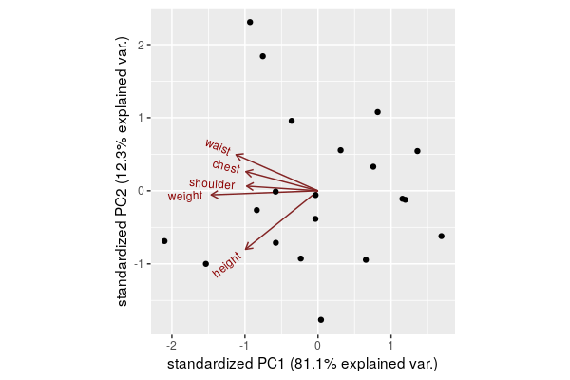
Back to the body data set
More than 90% of the variability explained by PC1 and PC2
Projecting to 2 dimensions means losing only 10%
PC1 = "beefiness"
Beefy people on the left, little people on the right
PC2 = Linked to height and waist girth
Up: waist, chest, shoulder
Down: height
Independent of weight!!

Slide 34


Linear combination... what?
The first PC is the linear combination of the original variables that maximizes the variance
PC1 = b1x1 + b2x2 + b3x3+…​
b1, b2, … are the loadings
| PC1| PC2| PC3| PC4| PC5|
|-----------:|-----------:|----------:|----------:|----------:|
| -41.3490569| -5.2918317| -3.4757211| 0.5998406| 2.7610345|
| -4.6318745| -7.1219025| -3.3882956| 4.3674016| -0.6620044|
| -16.4850973| -2.0325943| -7.3867086| -0.6465508| -0.7761349|
| 6.0942758| 4.2627477| 7.2736347| -1.3210720| 4.6080951|
| 26.7766941| 4.1731727| -3.7034380| -0.1170692| -0.4311311|
| 16.0734091| 8.2797866| -4.8741208| -3.8627731| 1.1451355|
| 22.7376385| -0.8405079| -0.8729392| 2.8024248| -1.4479241|
| 33.2397936| -4.7662644| -0.4976023| 0.0230917| 1.1011158|
| -14.8667533| 14.1456420| -0.8604570| -1.3106172| -1.6664648|
| -11.3556353| -5.4698990| -0.7004234| 2.0802661| -3.5871161|
| -0.6473919| -0.4525030| -1.2371792| 0.8120728| -1.3728803|
| -18.3067927| 17.7304476| 6.6287495| 5.0705482| -0.7032352|
| -30.2003955| -7.6849266| 1.0413105| -4.0507824| 0.4853862|
| -7.0897916| 7.3526336| -3.6265617| -0.4423416| 2.4758371|
| 12.8983336| -7.2556633| 4.5414048| -2.9803263| -4.1253349|
| 0.8096744| -13.5694388| 2.7073675| 2.9308574| 3.2492683|
| 14.8877207| 2.5301809| -5.9490910| -0.5940374| 0.9839424|
| -0.6939278| -2.9552783| 7.8148409| -2.2740671| 0.5919666|
| -11.4018371| -0.0889924| 3.6434606| -2.4078391| -3.1732391|
| 23.5110142| -0.9448088| 2.9217693| 1.3209730| 0.5436832|
pca1 <- prcomp(mat) pca1$x
pca1$rotation
| | PC1| PC2| PC3| PC4| PC5|
|:--------|----------:|----------:|----------:|----------:|----------:|
|shoulder | -0.3885045| 0.0654227| -0.8345117| 0.2996312| -0.2420652|
|chest | -0.3932741| 0.2670885| -0.1865393| -0.7539827| 0.4131736|
|waist | -0.4468633| 0.5038199| 0.4154087| -0.0260043| -0.6109321|
|weight | -0.5820975| -0.0568206| 0.2907425| 0.5155097| 0.5546642|
|height | -0.3948105| -0.8168969| 0.1081562| -0.2744172| -0.2996691|

Slide 35
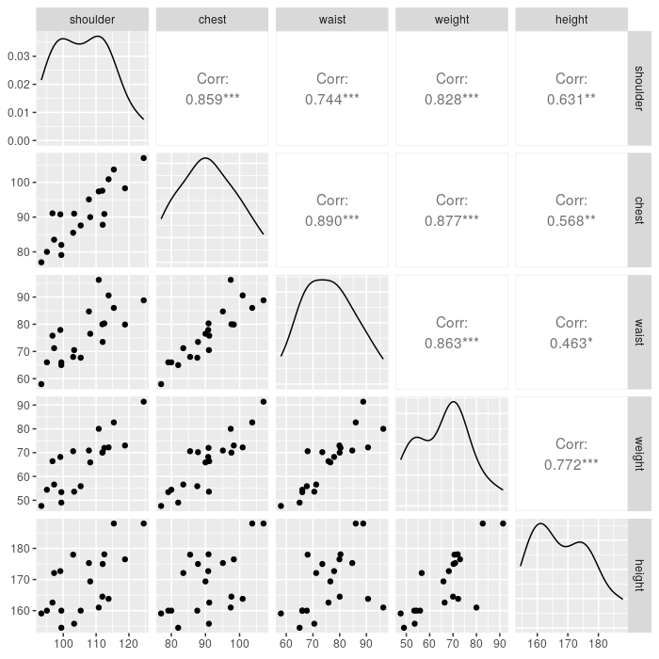
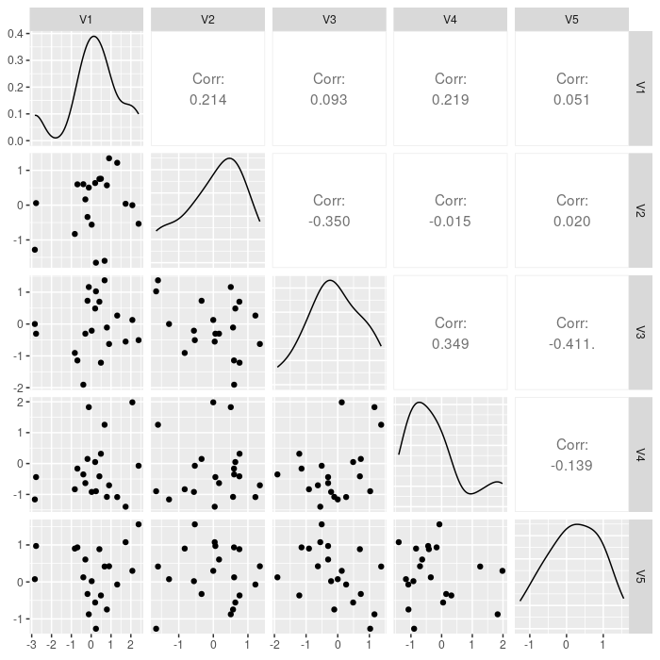
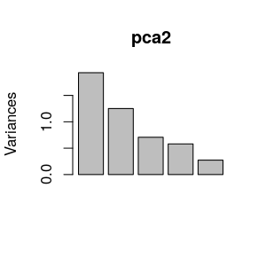
Correlation between body variables
What do you expect with non-correlated variables?

Slide 36
What is PCA used for
Extremely useful for visualising high-dimensional (correlated) data
Very useful to detect batch effects
Check association with sample variables!
Can be used to correct unwanted variation (e.g., GWAS, cell type composition)
Can summarise your data for downstream analyses (e.g., single-cell RNA-seq, cell type composition) PC1 is the "main line of variance" and can serve as a very good summary of your dataset (as long as it explains a lot of variance)

Slide 37
RNA-seq
in a nutshell

Slide 38
DNA-seq vs RNA-seq
The most common “omic” platforms
DNA variation | RNA profiling
Homogeneous (in space) | Heterogeneous (cells, tissues…)
Static* (in time): inert | Dynamic: responsive
Redundant | Necessary / sufficient
We care about the sequence (qual) | We care about the amounts (quant)
* just longer time-scales…

Slide 39
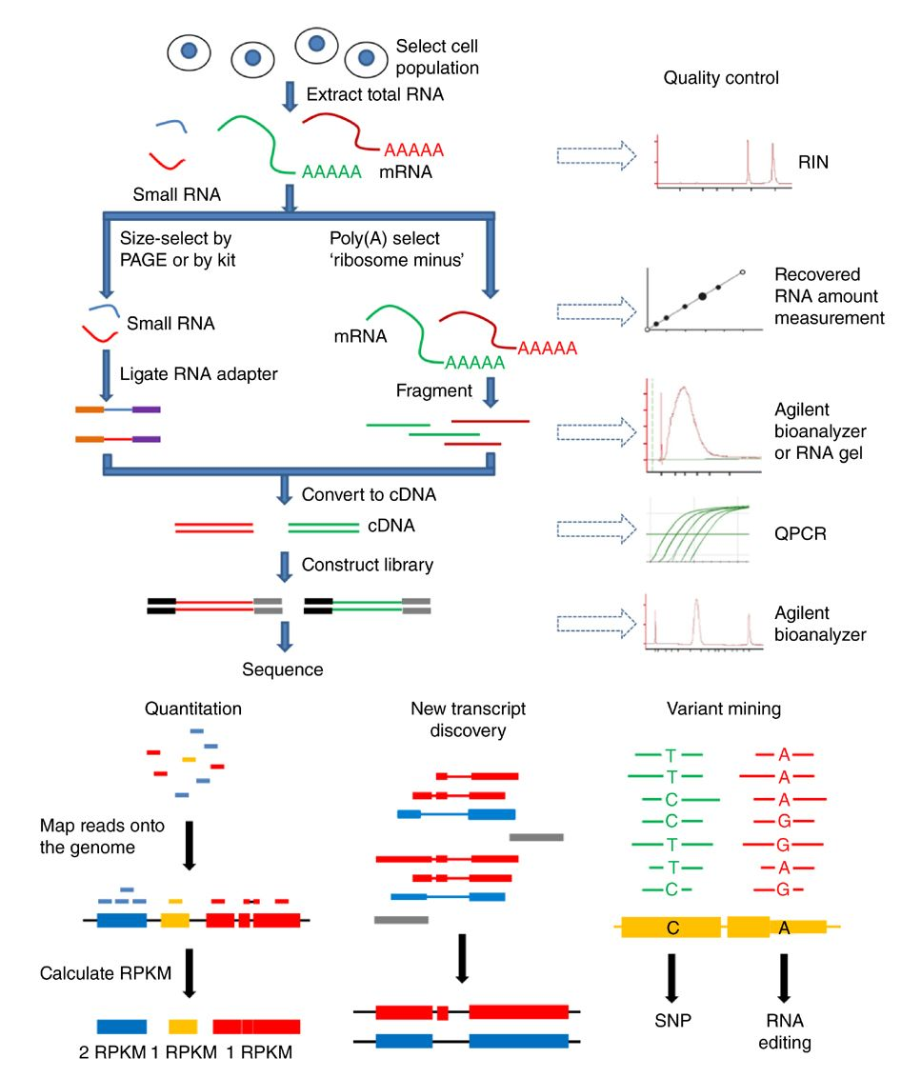
RNA-sequencing technology
https://cmb.i-learn.unito.it/mod/wiki/prettyview.php?pageid=139

Slide 40
RNA-seq options
Options
RNA isolation methods (rRNA removal, mRNA selection)
Read length (50, 75, 100…)
50 is enough for a global profiling
longer reads become important for de novo assembly and isoform quantification
Read depth per sample (most studies 30-60 million per sample)
20 million for “simple” transcriptome profiling (e.g., cell culture)
40 million for global profiling (e.g., total RNA, splicing isoforms, low-expressed transcripts)
150 million for assembly of new transcripts
Single-end vs paired-end
SE/PE for global gene expression profiling
PE for novel transcriptome assembly or degraded tissue
Number of replicates (absolute minimum: 2, minimum: 3)
Pooling of samples
More depth or more replicates? ALWAYS MORE REPLICATES

Slide 41
RNA-seq overview
Raw reads (FASTQ)
Alignment to transcriptome
Alignments (BAM)
Quantification
Read counts
Downstream analyses
There are a multitude of tools (and Review papers) for each of these steps!

Slide 42
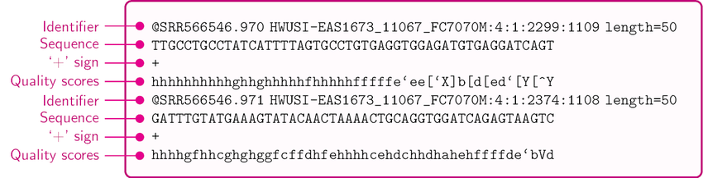
Raw reads: FASTQ format
FASTQ formatted data is what you generally get from the sequencing provider
Single-end?
sample01.fastq.gz
Paired-end?
sample01.R1.fastq.gz
sample01.R2.fastq.gz
Figure out which files correspond to which samples

Slide 43
Read alignment
Each read (or pair of reads) is aligned against the reference genome
Output: alignment file in BAM (or SAM) format
Splice-aware tools:
STAR
Hisat2
Alternatively, seudo- (or quasi-)alignment: just quantify
Salmon
Kallisto

Slide 44
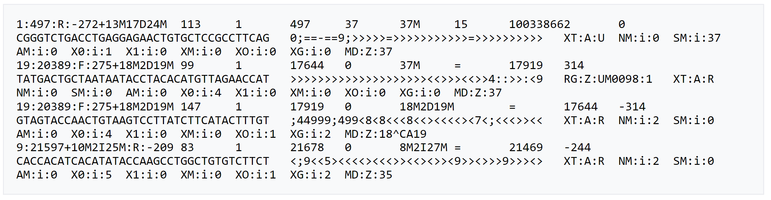
BAM/SAM format
BAM is just compressed SAM
Operating with these files usually via samtools or pysam package
It has a header followed by one read per line
it’s just a text file!

Slide 45
From FASTQ to differential expression in one slide
Nowadays, RNA-seq is very well established:
Linux bash
salmon quant -i hg38_index \ -1 sample01.R1.fastq.gz \ -2 sample01.R2.fastq.gz \ -p 8 --validateMappings
R
txi <- tximport(files, type = "salmon", tx2gene = tx2gene)
metadata <- read.table("samples.csv", sep = ",", header = T)
dds <- DESeqDataSetFromTximport(txi, colData = metadata, design = ~ age + sex + condition)
keep <- rowSums(counts(dds)) >= 10
dds <- dds[keep, ]
dds <- DESeq(dds)
res <- results(dds)
https://combine-lab.github.io/salmon/getting_started/

Slide 46
Before sequencing...

Slide 47
Experimental design in clinical science
Identify variables that may influence gene expression
Typically: age and sex
Often: batches (sequencing, cohort, time of sampling...)
PMI, RIN
Tissue composition (?)
Ensure your condition of interest is balanced in those variables
Complex experimental design? Groups should have similar sizes
Minimize batches!
The less people working on the sample prep the best (throughout all stages)
Same day, same time when possible (within each stage)
Use same reagent kit
Mix samples in same lanes when possible
All in the same sequencing run
Deviations need be documented
More replicates rather than more depth! There will be dropouts!

Slide 48
Metadata analysis
Most often you can look at the metadata before you sequence (even RIN)
Correlations between variables
Should not exist if the experiment was properly designed
Exceptions: RIN, cellularity
Condition of interest vs other variables
Confounding effect
Covariate vs covariate
Avoid collinearity in the linear regression

Slide 49
How do we assess association between variables?
Is condition associated with age?
is the average age different in cases and controls?
t-test (case/control), ANOVA (PD/AD/control)
Wilcoxon (case/control), Kruskal-Wallis (PD/AD/control)
Do we have an overrepresentation of muscle tissue for either cases or controls?
Contingency table
Chi-square / Fisher's test
Is RIN associated with age?
Pearson correlation
Spearman correlation
sample_id | individual | sex | RIN | age | tissue | condition
pfctx001 | KBR | M | 8.2 | 38 | muscle | control
pfctx002 | FDI | F | 7.7 | 34 | muscle | control
pfctx003 | GNI | M | 4.2 | NA | muscle | control
pfctx004 | CTZ | M | 8.1 | 42 | muscle | case
pfctx005 | CTZ | M | 9.0 | 42 | PFC | case
... | ... | ... | ... | ... | ... | ...
pfctx059 | JLO | F | 2.3 | 51 | muscle | case

Slide 50
After sequencing...

Slide 51
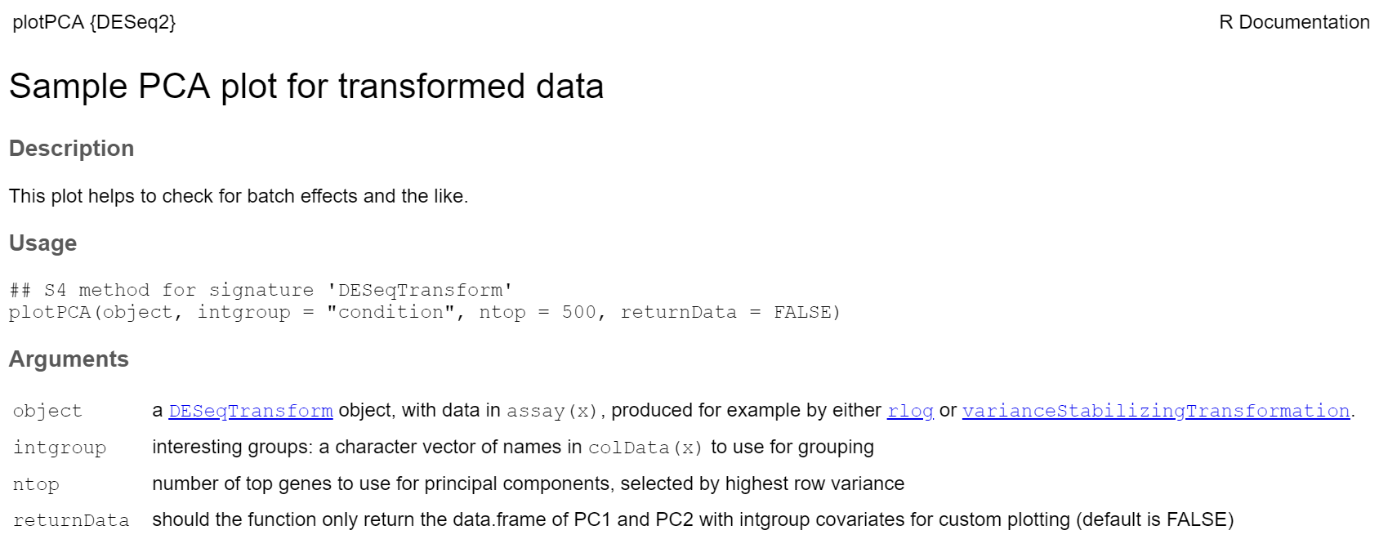
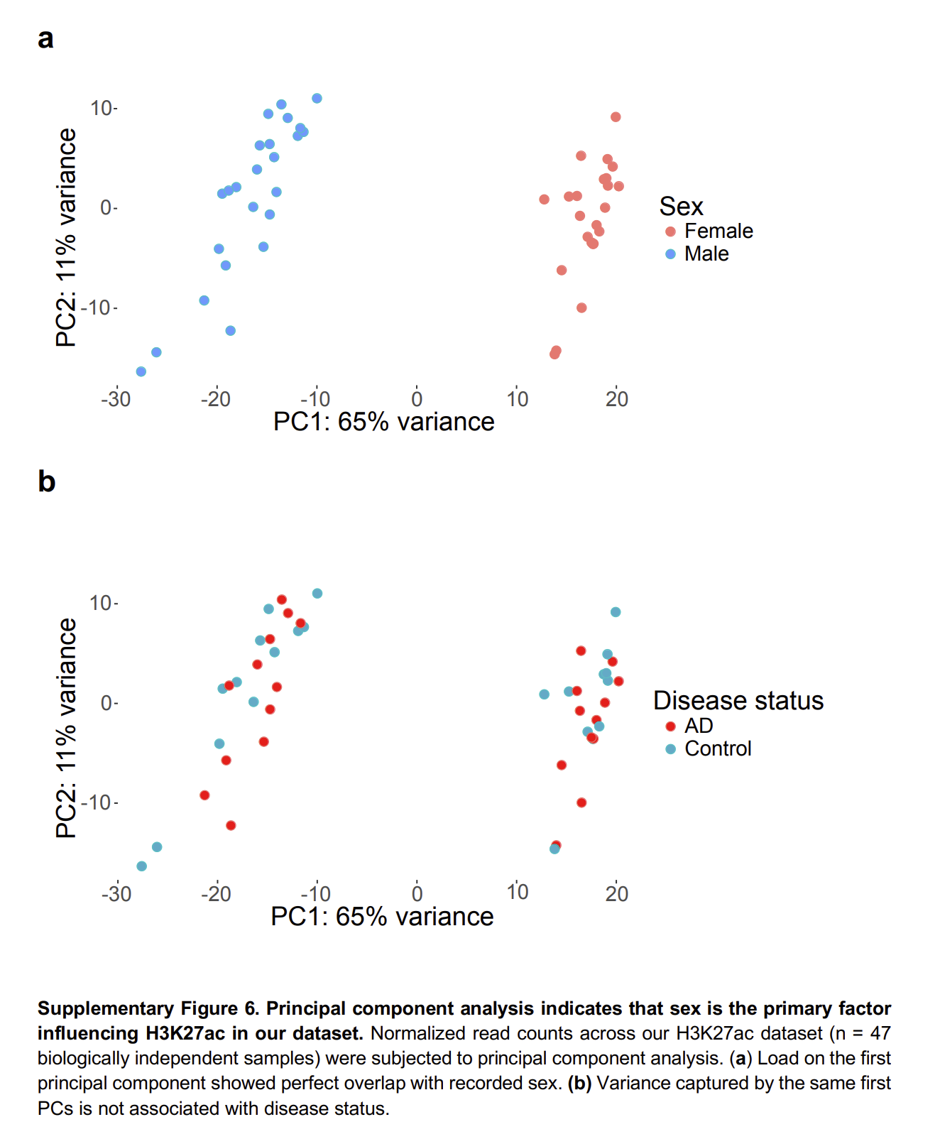
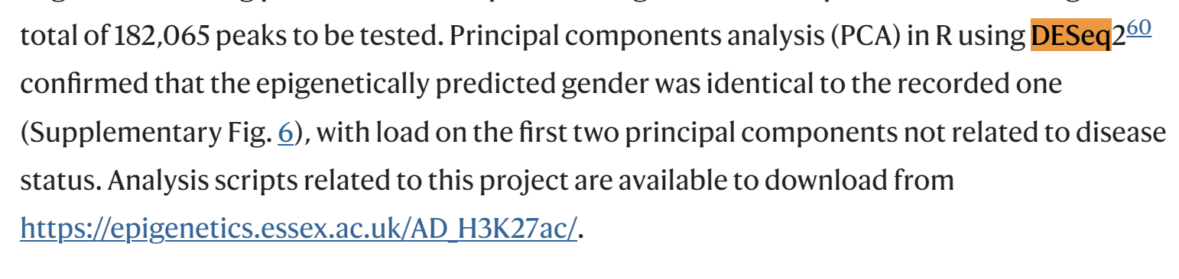
Filtering features
This is boring, but important
Very specific to each platform
For bulk RNA-seq:
Do you want genes or transcripts?
Filter low-expressed genes
e.g., keep only genes with at least 10 reads in 25% of the samples
Consider removing genes in non-canonical chromosomes
Consider removing non protein-coding genes
Consider removing mtDNA/ribosomal genes
Pay attention to genes located in sex chromosomes

Slide 52
Exploring gene expression data*
Normalize the data
Divide counts by library sizes (sum of all counts in a sample)
More sophisticated methods, of course
Count data typically requires a log transformation to bring it to shape
gene_id | pfctx001 | pfctx002 | ... | pfctx059
A1BG | 1024 | 873 | ... | 12
A1CF | 12 | 23 | ... | 11
A2M | 4888 | 9383 | ... | 3334
A2ML1 | 498 | 477 | ... | 501
A3GALT2 | 10323 | 9123 | ... | 8767
... | ... | ... | ... | ...
ZZZ3 | 34 | 52 | ... | 101
* Valid for any other big data platform!

Slide 53
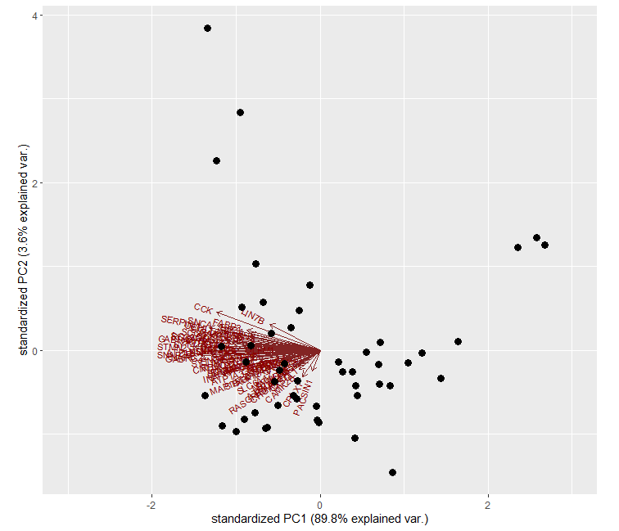

Estimation of cell types
Especially important in some tissues: brain and blood/PBMC
Multitude of methods
Marker Gene Profiles
Bisque
ABIS
CETS (brain, methylation)
CIBERSORT
SCADIE
DAISM-DNN

Slide 54
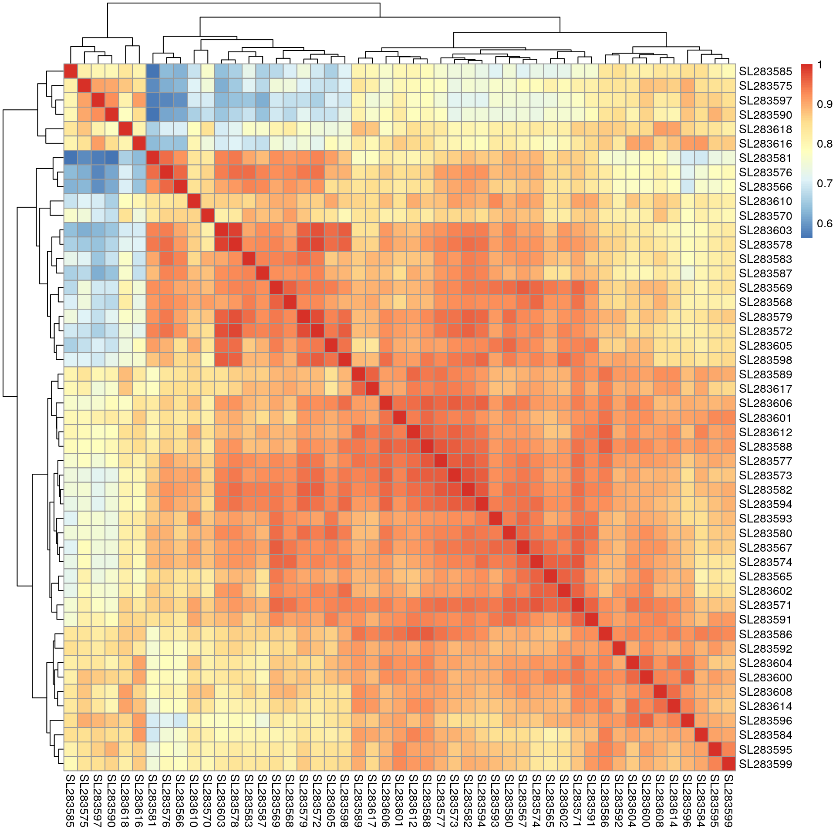
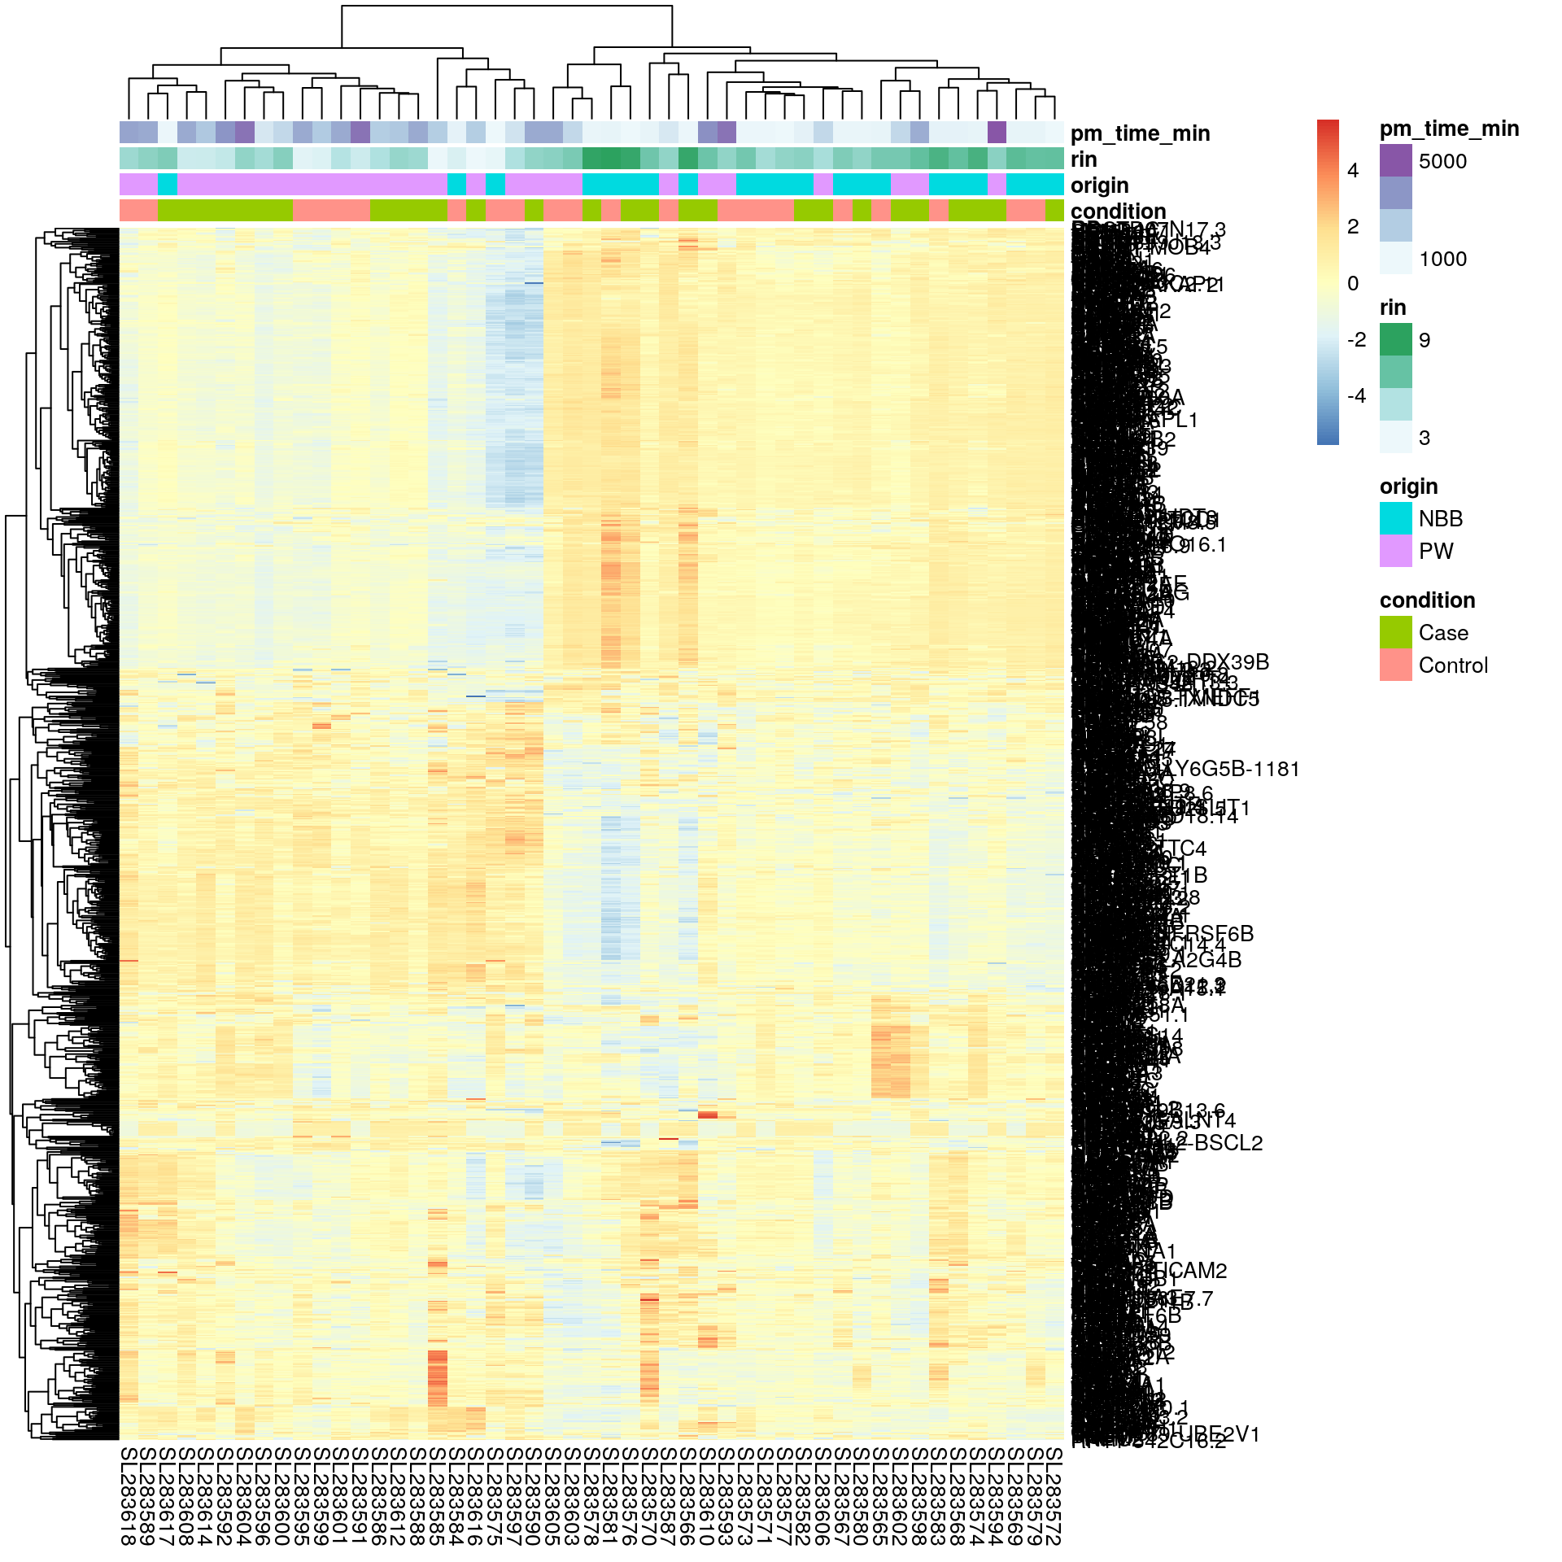
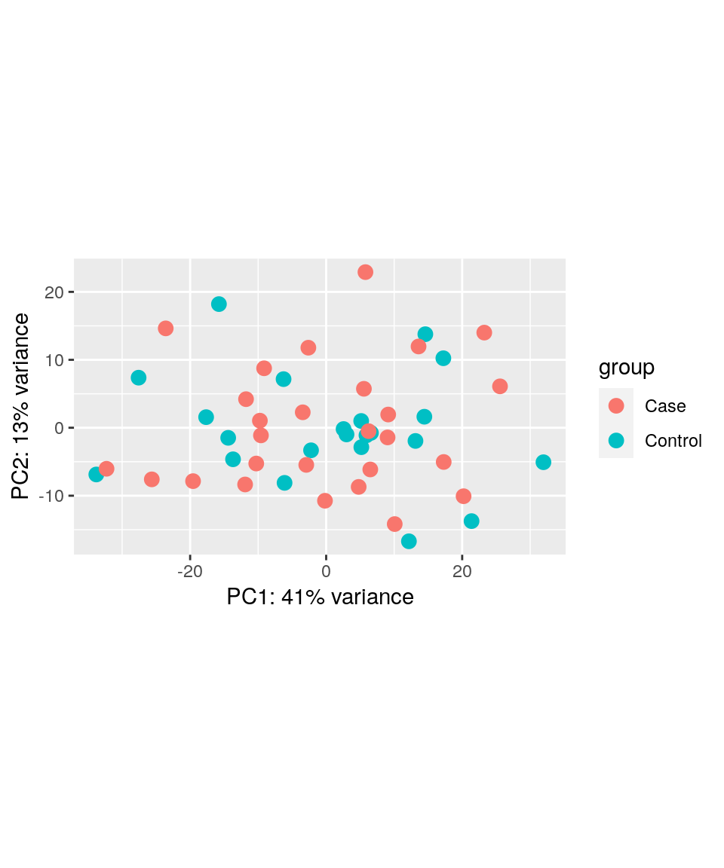
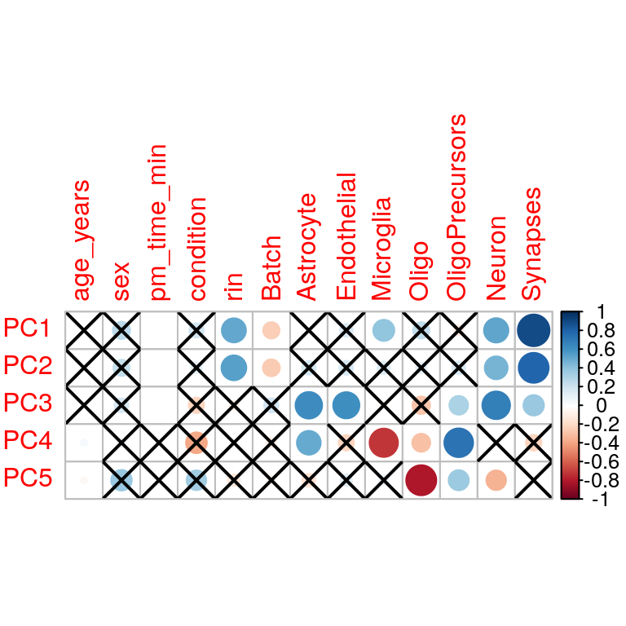

Exploring gene expression data*
PCA
Color by sample variables
Test for association of main lines of variation with sample variables (including cell type estimates)
Detect outliers
Correlations in expression between samples
Identify potential outliers
Heatmap of expression
Typically, on most varying genes
Clustering of samples
clustering

Slide 55
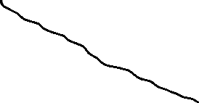
Differential gene expression
PDE10A
Decide on the covariates to model
Confounded vs explaining noise
"Regressing out" vs "accounting for"
Adding PCs vs "adding covariates"
Surrogate Variable Analysis (SVA) / RUVseq?
Fit a (generalized) linear model for each gene
Model gene expression of gene i by the effect of covariates
expression_{i} = b₀ + b₁*age + b₂*sex + b₃*condition
Test whether b₃ (the slope) is significantly different from 0
Wald test
DESeq2: the slope (or "effect size") corresponds to the log2 fold change
Multiple testing correction
gene expression
condition
one per gene!!

Slide 56
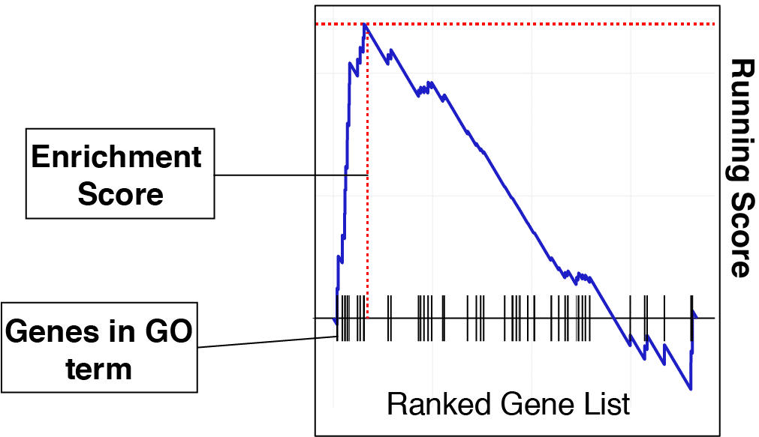
Gene set enrichment analysis (GSEA)
Hundreds of significant genes – how to summarize my findings?
Test for enrichment of functionally related genes either in the top or the bottom of the ranked list of genes
Ranked by –log(p), by stat, by log2foldchange

Slide 57
We are done with theory for today!

Slide 58
Extending to single cell RNA-seq
A primer

Slide 59


RNA-seq: human brain tissue
Bulk tissue comes with an inherent heterogeneity in cellular composition
Biological differences (e.g., secondary to neurodegeneration)
Neuronal loss and gliosis (especially in affected areas, e.g., SNc in PD)
Technical variation in sample dissection and preparation
Uneven distribution of gray and white matter → variable fraction of oligodendrocytes

Slide 60


Other omic layers - proteomics
PSP is characterized by substantial neuronal loss in the globus pallidus
Jang et al. identified hundreds of differentially expressed proteins between PSP and healthy control samples
Suggested a down-regulation of mitochondrial pathways
Neuronal estimates were significantly decreased in PSP and highly associated with the general protein expression pattern
The significance of mitochondrial signal was lost
Notes:
a -> our paper

Slide 61

Other omic layers - acetylation
Increased histone acetylation and histone protein levels in the PD brain
Cell composition is a major source of variation in bulk tissue H3K27ac ChIP-seq data

Slide 62


Other omic layers
Can we simply adjust for sample cellularity?
Neighboring brain tissue samples exhibit substantial interindividual variation in cell composition
Minimal to no correlation between omic layers!!
Nuclear omics modalities (WGBS and H3K27ac) are more similar to each other than to transcriptomics-based estimates derived from whole tissue omics data
Notes:
2) Is nucleus vs cell

Slide 63



scRNA-seq
Gel Beads, cells or nuclei, enzymes, and partitioning oil are loaded onto a Next GEM chip
Barcoded Gel Beads are mixed with the cells or nuclei, enzymes, and partitioning oil to form tens of thousands of GEMs
Each GEM acts as an individual reaction droplet in which the Gel Beads are dissolved and molecules of interest from each cell are captured and barcoded
Fragments from the same cell or nucleus share a common 10x Barcode. Barcoded fragments are pooled for downstream reactions to create short-read NGS libraries
Notes:
Remove this

Slide 64
Alignment
We need specialized alignment software: forward and reverse reads contain different type of information
Cellranger, STARsolo, Allevin
First read
26 bp long
16 bp cell barcode
10 bp UMI
Second read
100 bp recommended
mRNA sequence

Slide 65
Count matrix in scRNA-seq
RNA-seq
Limited columns (observations)
Single cell RNA-seq
Columns in the (hundred) thousands
Nested design
gene_id | pfctx001 | pfctx002 | ... | pfctx059
A1BG | 1024 | 873 | ... | 12
A1CF | 12 | 23 | ... | 11
A2M | 4888 | 9383 | ... | 3334
A2ML1 | 498 | 477 | ... | 501
A3GALT2 | 10323 | 9123 | ... | 8767
... | ... | ... | ... | ...
ZZZ3 | 34 | 52 | ... | 101
gene_id | pfctx001 |  |  |  | pfctx002
 | cell_1 | cell_2 | ... | cell_4322 | cell_1 | cell_2 | ...
A1BG | 1024 | 873 | ... | 12 | 432 | 45 | ...
A1CF | 12 | 0 | ... | 11 | 346 | 913 | ...
A2M | 4888 | 9383 | ... | 3334 | 44 | 36 | ...
A2ML1 | 498 | 477 | ... | 501 | 0 | 9 | ...
A3GALT2 | 10323 | 9123 | ... | 8767 | 57 | 0 | ...
... | ... | ... | ... | ... | ... | ... | ...
ZZZ3 | 0 | 52 | ... | 101 | 0 | ... | ...

Slide 66

Advantages of scRNA-seq
Quantify cellularity
Identify novel cell types or cell type subpopulations
Identify cell type markers
Differential expression within cell types
Cell type trajectories

Slide 67
Challenges
Library preparation
Can we even isolate cells? Do we need to resort to nuclei?
Are we missing some cell types / enriching for some other cell types?
Economical constraints
Library prep / sequencing costs
Computational costs
Computational requirements
Not so much in terms of storage
typical bulk RNA-seq sample: 10-30Gb
10x Genomics sample: 50-70Gb
But beware of computation
50 samples: 256 Gb RAM!
Much more complex downstream analyses than bulk RNA-seq
Identify empty droplets / multiplets
Remove background RNA
Filter low-qual droplets
Identify cell types

Slide 68
RNA-seq hands-on

Slide 69
Hands-on for RNA-seq
Real dataset from a publication on Parkinson's disease brain vs healthy controls
Part 1: Fetching and examining data
part1_instructions.nb.html
Part 2: RNA-seq analysis
part2_instructions.nb.html
Rmd (R markdown) files
Text files that have text (markdown format) and chunks of R code
They can be compiled into html, pdf... combining the text, the code, and the results generated by executing the code
Can be opened with Rstudio and edited, tested, etc...

Slide 70

Files needed

Slide 71
Solutions?
Yes, they will be available!
"solutions" folder

